Slide 1
Implementation
Josh Houston
Nick McMahon
Tianran Hao (Chris)
Eric Blumenstock

Slide 2
How did we Implement?
Language?
C# Application Windows Form
Methodology?
Rapid Prototyping
How we split up the work?
Nick – Dimensional change calculation
Chris – Density calculation
Eric – Beam deflection calculation
Josh – database, displaying categories, species, and species description

Slide 3
SQLite
What is it?
SQLite is a software library that implements a self-contained, serverless, zero-configuration, transactional SQL database engine.
How does it work?
Download from there site, run the sqlite application, which is command-line based, create a database file, and begin creating tables and adding data.
How does it integrate?
With a C# application like we developed, you can download the SQLite package within Visual Studio and reference to the project which will allow, opening connection, closing connections, and reading data from your created database.
SQLite

Slide 4
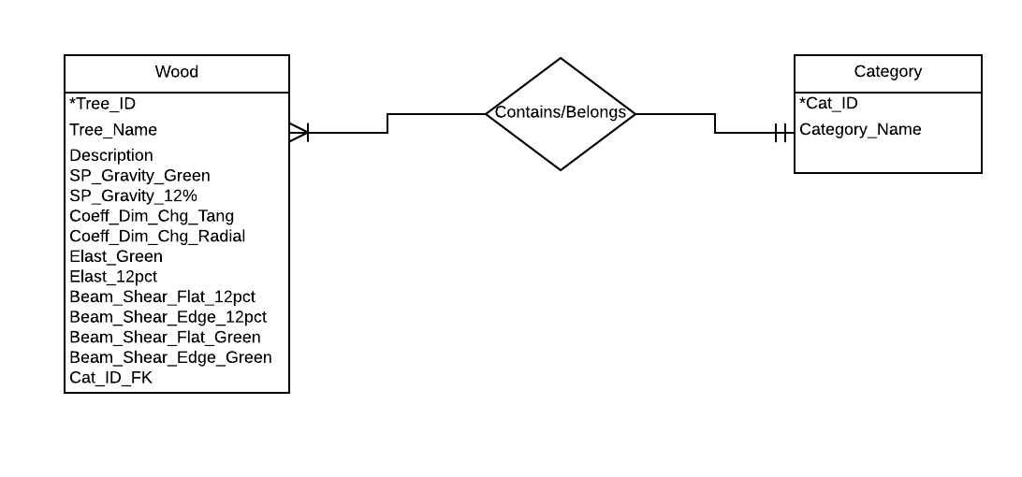
ERD Diagram

Slide 5
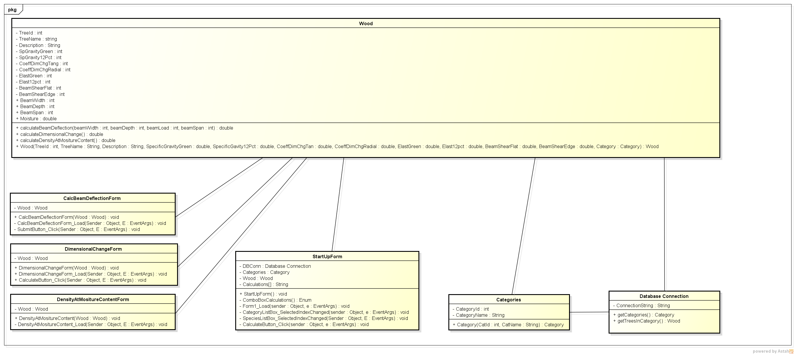
UML Diagram

